Slide 1
The Necessity for Oil Analysis and Filtration in Hydraulic Elevators
Michael Johnson

Slide 2
80%
Up to 80% of failures in an oil system are related to oil quality.

Slide 3
20%
20% of the valves returned for repair under warranty are contaminated
Source: Maxton Valve

Slide 4
90%
90% of the valves returned for repair after the warranty period are contaminated
Source: Maxton Valve

Slide 5
The Hydraulic Oil Is The Lifeblood Of The Hydraulic System
Oil Touches all vital components
Performs vital tasks
Submersible Motor
Valve
Seals
Power Transfer Media
Lubrication
Disperses Heat
Supports the weight of the car
Prevents rust
Dielectric

Slide 6
The Hydraulic Oil Is The Lifeblood Of The Hydraulic System
Equipment Failure
Operational Issues
Valve Failure
Submersible Pump Failure
Hydraulic Seal Failure
Overheating Oil
Piston Damage
Leveling Issues/Tripping Hazard
Vibrations/Noise
Valve Adjustments
Spongy Feeling at top floor
Slow Speeds
Smelly Oil

Slide 7
Run To Failure
The oil was not addressed in the contract. Who owns the oil?
The oil was not address in the A17 Safety Code.
Oil was cheap.
There was no standard for good oil.
There was not a good solution.

Slide 8
Oil Replacement
Up to 70% of the oil life can be lost to reactive material in a dirty system.
Clean Oil has a solvent effect and can re-contaminate the system within weeks.
The oil is usually not bad; it is just dirty.
Created an adversarial relationship.

Slide 9
Unique Demands of Hydraulic Elevators
Fixed Displacement Pumps
Undersized Reservoirs
No standard operating temperature
Leveling
No inline filtration
Long pipe runs
The Human Factor

Slide 10
40+ Years
Gorman Co. began looking at the oil in hydraulic elevators over 40 Years Ago.
Developed a standard that is specific to elevators.
Standardized test are interpreted for the unique needs of hydraulic elevators.

Slide 11
Advantages of Routine Oil Analysis
Creates expectations for the Service Company and the University.
Identifies potential problems, before they cause an unplanned outage.
Tailors the maintenance routine to each elevator.
Eliminates waste and saves money.

Slide 12
What Should The Oil Look Like?
Viscosity – The Oil’s resistance to flow.
Viscosity Index - A measure of the stability of the viscosity between 40⁰1C - 100⁰C.
ISO Cleanliness Code – Particles per ml of oil at 4µ/6µ/14µ
Moisture Content – Water is the most common chemical contaminant in the hydraulic oil.
Acid Number – A measure of base oil degrading; used for trending.

Slide 13
Viscosity – ASTM D445 MOD
High Viscosity
Low Viscosity
Wasted Energy
Overheating
Cavitation
Can indicate polymerization
Metal wear
Seal wear
Can indicate oxidation

Slide 14
Viscosity – ISO 32
The Hydraulic Elevator was designed around AW32
ISO 32
32cTs @ 40℃
5.7cTs @ 100℃
Anti-Wear (AW)
Zinc ≈ 250ppm
Phosphorus ≈ 250ppm
Calcium ≈ 65ppm
Other additives are limited
NZ
Tractor Fluid
Boron
Barium
Molybdenum

Slide 15
Viscosity Index (VI) – D2270
The stability of the viscosity over a range of temperatures
ISO 32
32cTs @ 40℃
5.7cTs @ 100℃
(VI) <90
Elevators do not have a normal operating temperature.
A symptom of low VI is a valve that is difficult to set or repeated callouts for leveling issues.
Missing the floor or re-leveling.

Slide 16
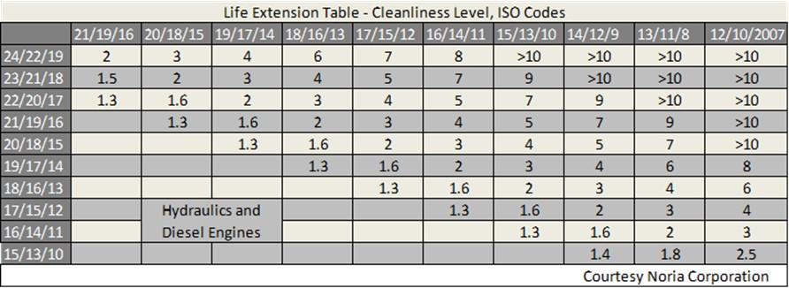
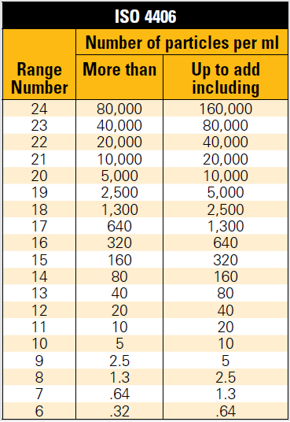
ISO Cleanliness Code – ISO 4406:99

Slide 17
ISO Cleanliness Code – ISO 4406:99

Slide 18
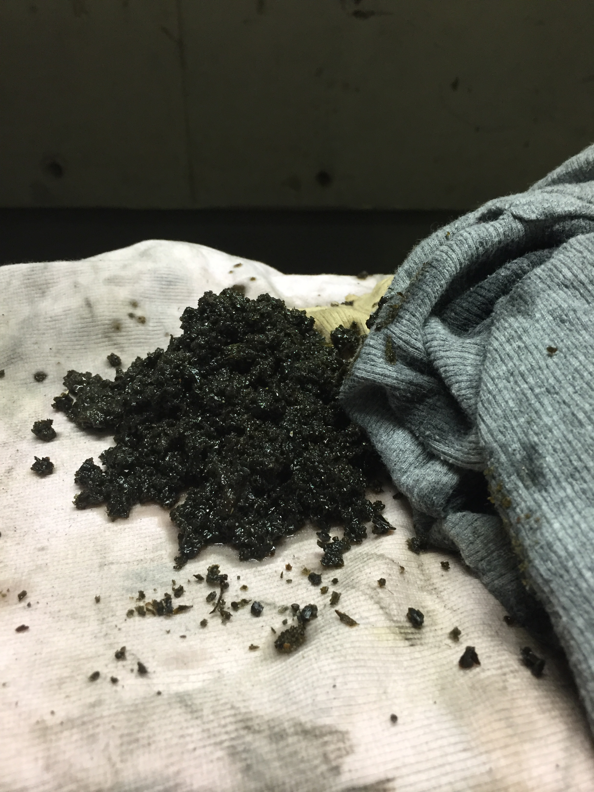
ISO Cleanliness Code – ISO 4406:99
The valve was set at the factory with clean oil.
Particle contamination can alter valve performance.
20% of the valves returned for repair under warranty are contaminated. (Maxton Valve)
90% of the valves returned for repair after the warranty period are contaminated. (Maxton Valve)

Slide 19
Moisture Content – ASTM D6304
Water is the most common chemical contaminant found in the hydraulic oil.
Hydraulic Elevators have open reservoirs.
New oil is not necessarily dry oil.
Even small amounts of moisture can cause operational problems.
Air Entrainment
Sponginess at upper floors
Overheating in the reservoir
Microdieseling
Loss of lubrication film
Additive Depletion

Slide 20
Moisture Content – ASTM D6304

Slide 21
Moisture Content – ASTM D6304

Slide 22
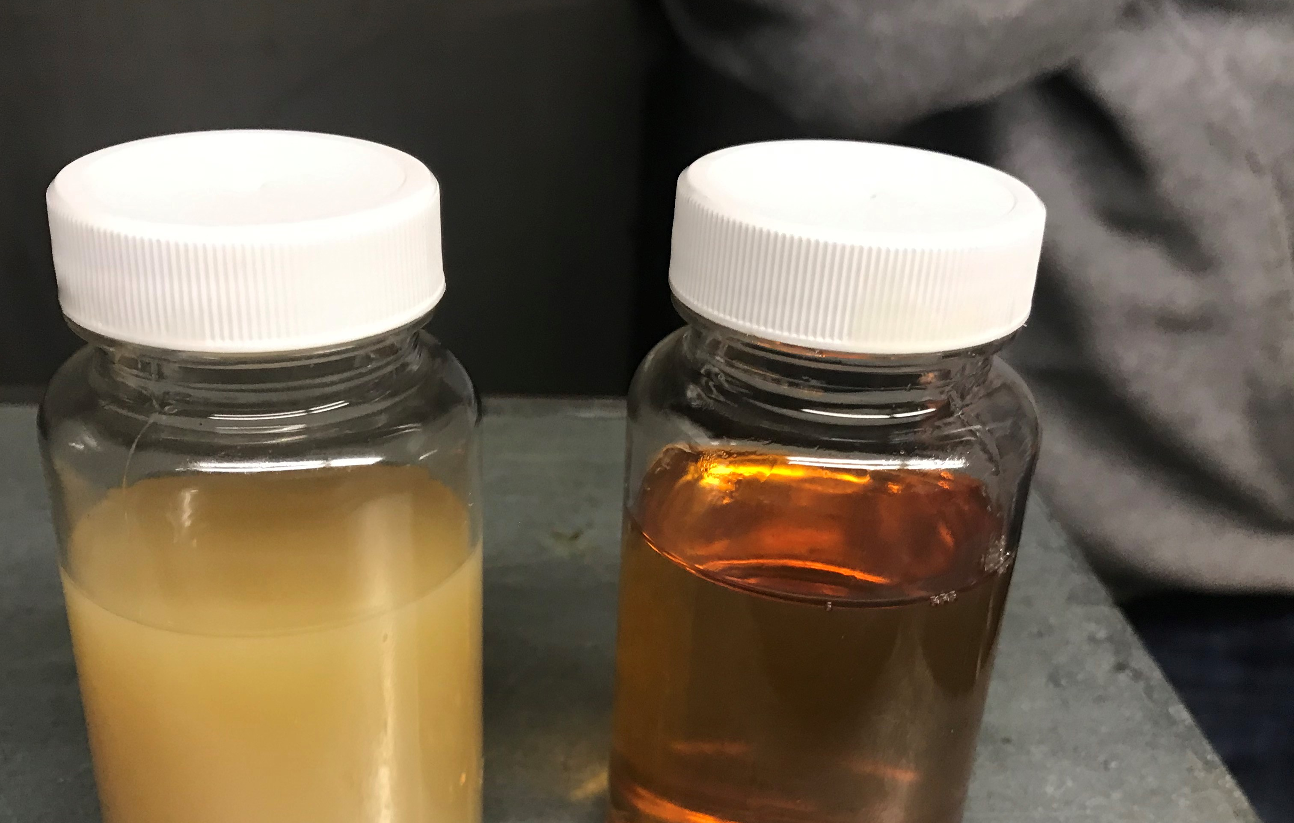
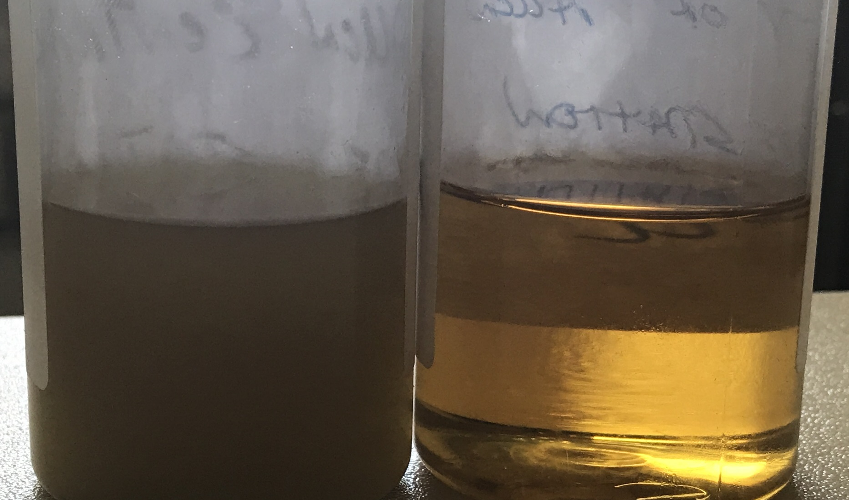
Moisture Content – ASTM D6304
Mineral oil has good demulsibility
Moisture will reverse the esterification process used to make vegetable oil.
Tractor Fluid has detergents that absorb moisture.

Slide 23
Acid Number – ASTM D445 MOD
Used for trending
A decrease in AN is an indication of additive depletion.
Increases in AN indicate base oil oxidation.
My mineral oil baseline is 0.3
Vegetable oil AN is 0.75 – 1.0
Tractor Fluid AN is 0.3 – 0.5
Non-Zinc oil AN < 0.1
The AN can be adjusted with the addition of top-off oil.
The best additive for AW32 is MORE AW32.

Slide 24
The Oil Analysis Process
All Testing materials are provided to TK Elevator
Each Elevator is assigned a Control
All samples are sent to an independent lab for testing
OilScrubber.com interprets the results as they relate to elevators
Reports are distributed to TK and the University
OilScrubber.com retains the past reports for trending

Slide 25
70%
Up to 70% of the oil life can be lost to reactive material in a dirty system.
Clean Oil has a solvent effect and can re-contaminate the system in weeks.
The oil is usually not bad; it is just dirty.

Slide 26
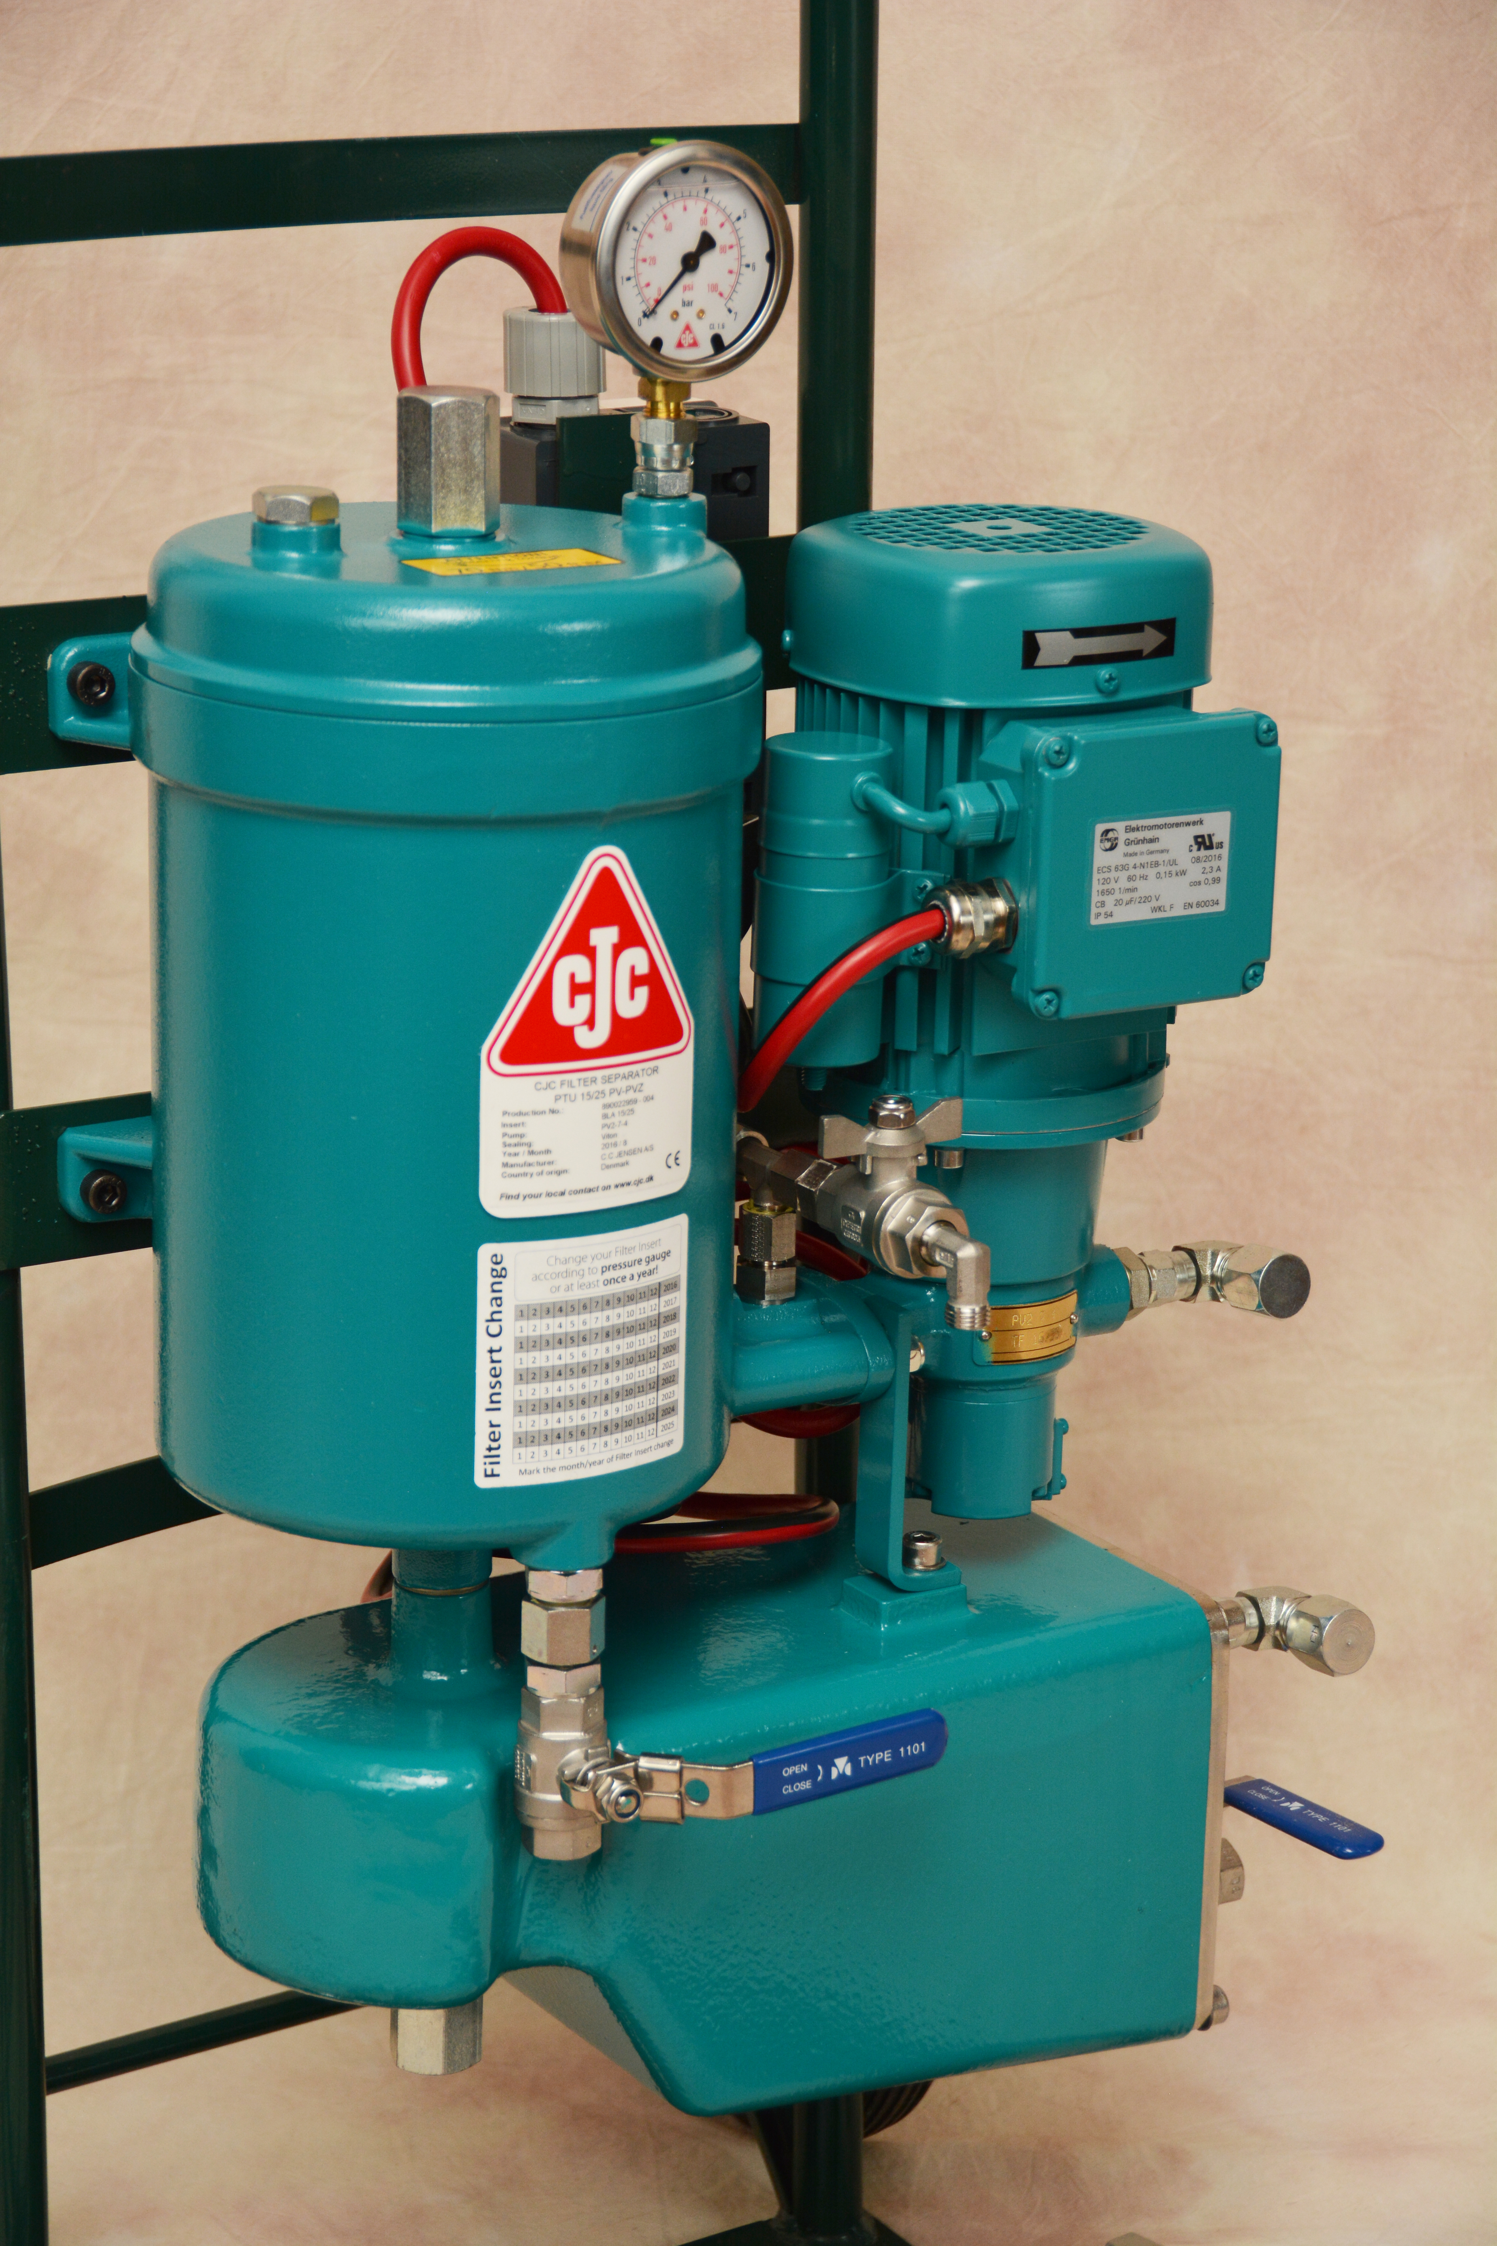
Offline Filtration
Offline Filtration is a cost-effective way to extend the life of the oil and hydraulic system.
Oil replacement only removes dissolved contaminates in the oil. Reactive material remains and re-contaminates the system.
Typically, the oil is not bad, it is just dirty.

Slide 27
OilScrubber.com
Removes water and particles at the same time
Designed for continuous duty
Quiet
Portable

Slide 28
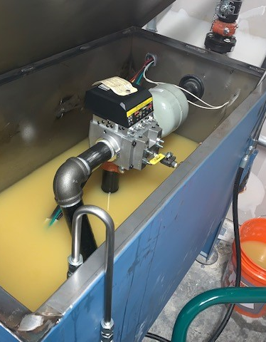
OilScrubber.com
3µ filtration
Removes water two ways
Reduces moisture below 100ppm
Removes reactive material

Slide 29
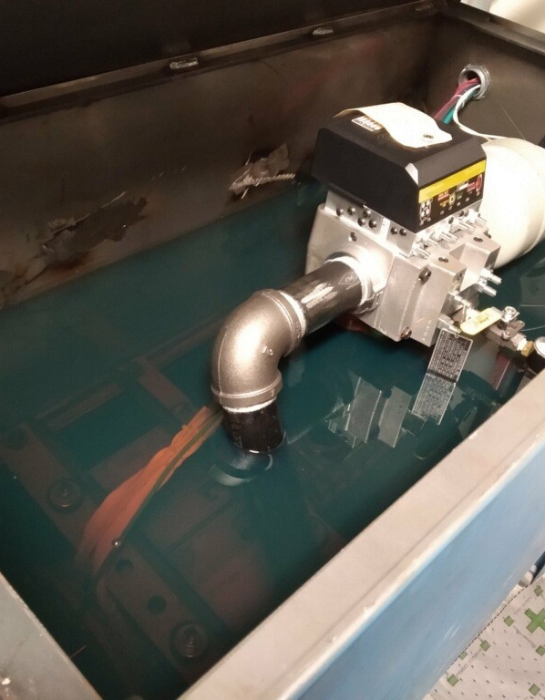
OilScrubber.com
3µ filtration
Removes water two ways
Reduces moisture below 100ppm
Removes reactive material

Slide 30
OilScrubber.com
Before
After

Slide 31
Varnish Removal
Varnish can be filtered with a depth filter if the oil is below 104°F.
Clean oil has a solvent effect.
No harsh solvents are added to the system.
The more the elevators runs, the better it cleans.

Slide 32
Oil Scrubbing vs Oil Replacement
Oil Scrubbing
Oil Replacement
The Elevator does not have to be shut down.
Environmentally Responsible
Scrubs the entire hydraulic system
Cost effective, the old oil can be re-used.
Turns the oil over daily.
The Elevator must be shut down for multiple days.
Disposal and transportation of used oil.
Only removes dissolved contaminates in the oil.
Oil must be replaced multiple times.

Slide 33
Conclusion
Oil Analysis combined with offline filtration is a holistic approach to reduce cost and extend the life of hydraulic elevators.
Data driven maintenance reduces uncertainty and builds consensus between the Service Company and the University.
Replacing the oil does not necessarily fix the problem.
The solution does not have to be expensive to be effective.

Slide 34
THANK YOU
Michael Johnson
Gorman Co.
OilScrubber.com
(972) 533-3285

